Slide 1
Digital First Communications:
Driving On-going Member Engagement and Satisfaction
Jennifer Cummings
Public Relations & Marketing Coordinator
Horry Electric
Jennifer.Cummings@horryelectric.com
Danny Watkins
Senior Account Manager
Apogee Interactive
dwatkins@apogee.net

Slide 2
About Horry Electric
90,700 Meters
Unique Area
Serves 1 county with 5,700 miles of lines
Large number of new members onboarding
18,278 new members added over the last three years
20% increase during this span
Notes:
Anything else you would like to mention?

Slide 3
Market Leader in Customer Engagement
Celebrating 30 Years of Success
Serving Hundreds of North American Utilities
Reaching Tens of Millions of Customers
Providing Software as a Service (SaaS)
Delivering
Increased Customer Satisfaction
Heightened Customer Engagement
Energy Efficiency and Revenue Generating Program Promotion
Distinctive: Top-Rated Data Analytics and Predictive Modeling
Industry’s Most Comprehensive Customer Engagement Platform
Consistency Creates Customer Trust

Slide 4
First Class Member Engagement
Notes:
Insert Graph with the scores

Slide 5
Constant & Relevant Messaging
Over 820,000 messages sent the last 12 months
48% Open Email Rate (Industry standard is 30-35%)
1,351 were new contacts added in the last 90 days
Very few members unsubscribe to the messages (about 1%)
Example messages:
Incentive Tools in Oct 2022
Smart Thermostat Program sign up in Nov 2022
Bank Draft Sign Up Promotion in Dec 2022
Youth Trips and Scholarships in Jan 2023
E-Bill sign up in Feb 2023
Notes:
Compare the Open email rate. Is this a regular or unique?

Slide 6
Call To Action Incentives
Money Talks
$100 or $50 bill credits
$250 Christmas cash prize was offered in November for the Smart Thermostat Promotion

Slide 7
Horry’s Unique Messages
Apogee Video Bill Messages
Over 56,000 messages sent
61% Unique Open Rate
18,4% Unique Click Through Rate (Industry standard: 3.5%)
*Numbers indicate a 12-month period

Slide 8
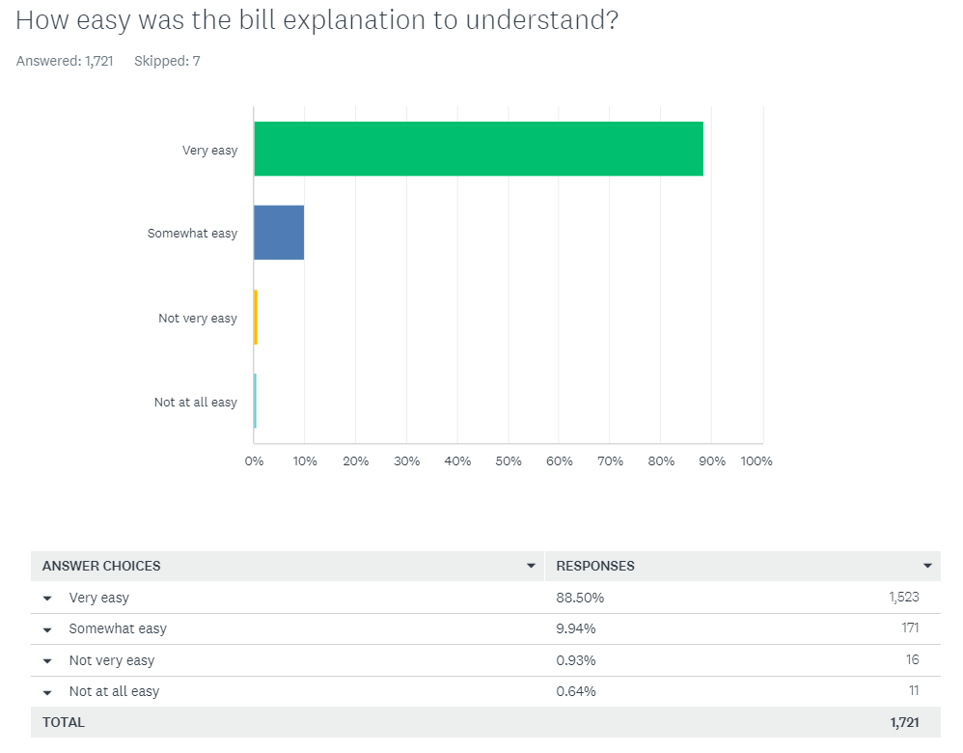
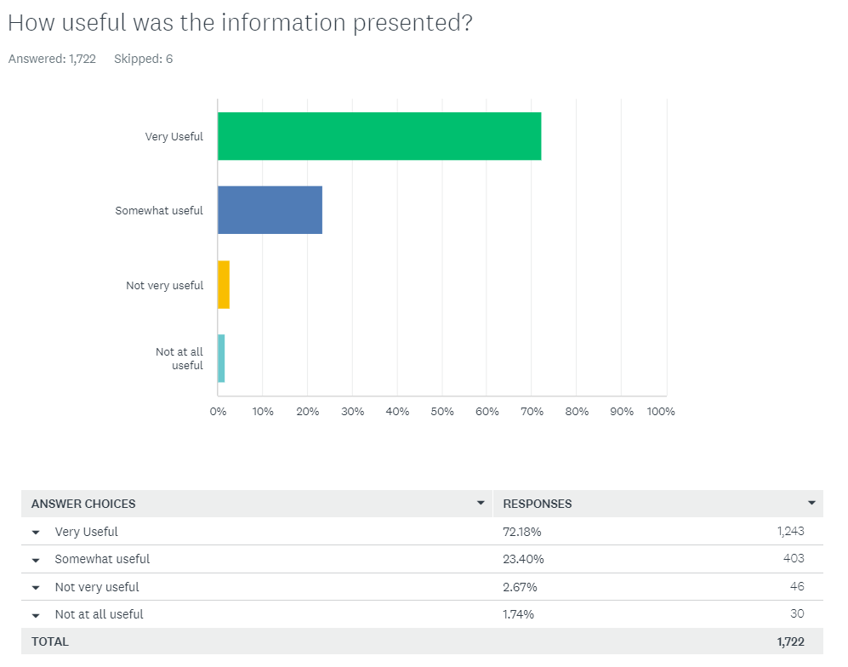
Horry Survey Results (Video Bill Explanations)
~98% Easy
~96% Useful

Slide 9
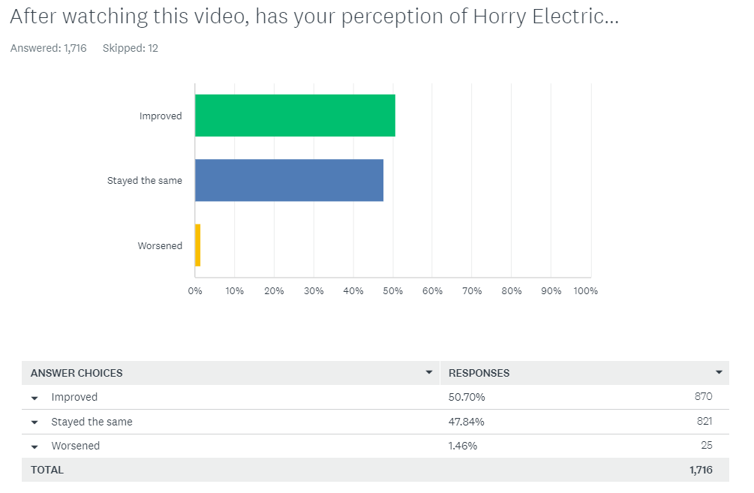
Survey Results (Cont.)
Sample Feedback
This was a really nice idea to help us understand. Thank you.
Yes, I understand more about heating my home now
I appreciate the video & the notification. Great job, thank you!!
The video was excellent and I'm sure much of the increase was due to heating the outside Spa.
I think you do a great job all the time. I like the video breakdown although I pretty much know how I lowered my bill. Thanks for all you do to help us save energy.
I was very delighted with the video .it was very easy to understand and the way it broke down the different amounts made it very informative. I hope you do this again.
51% Improved

Slide 10
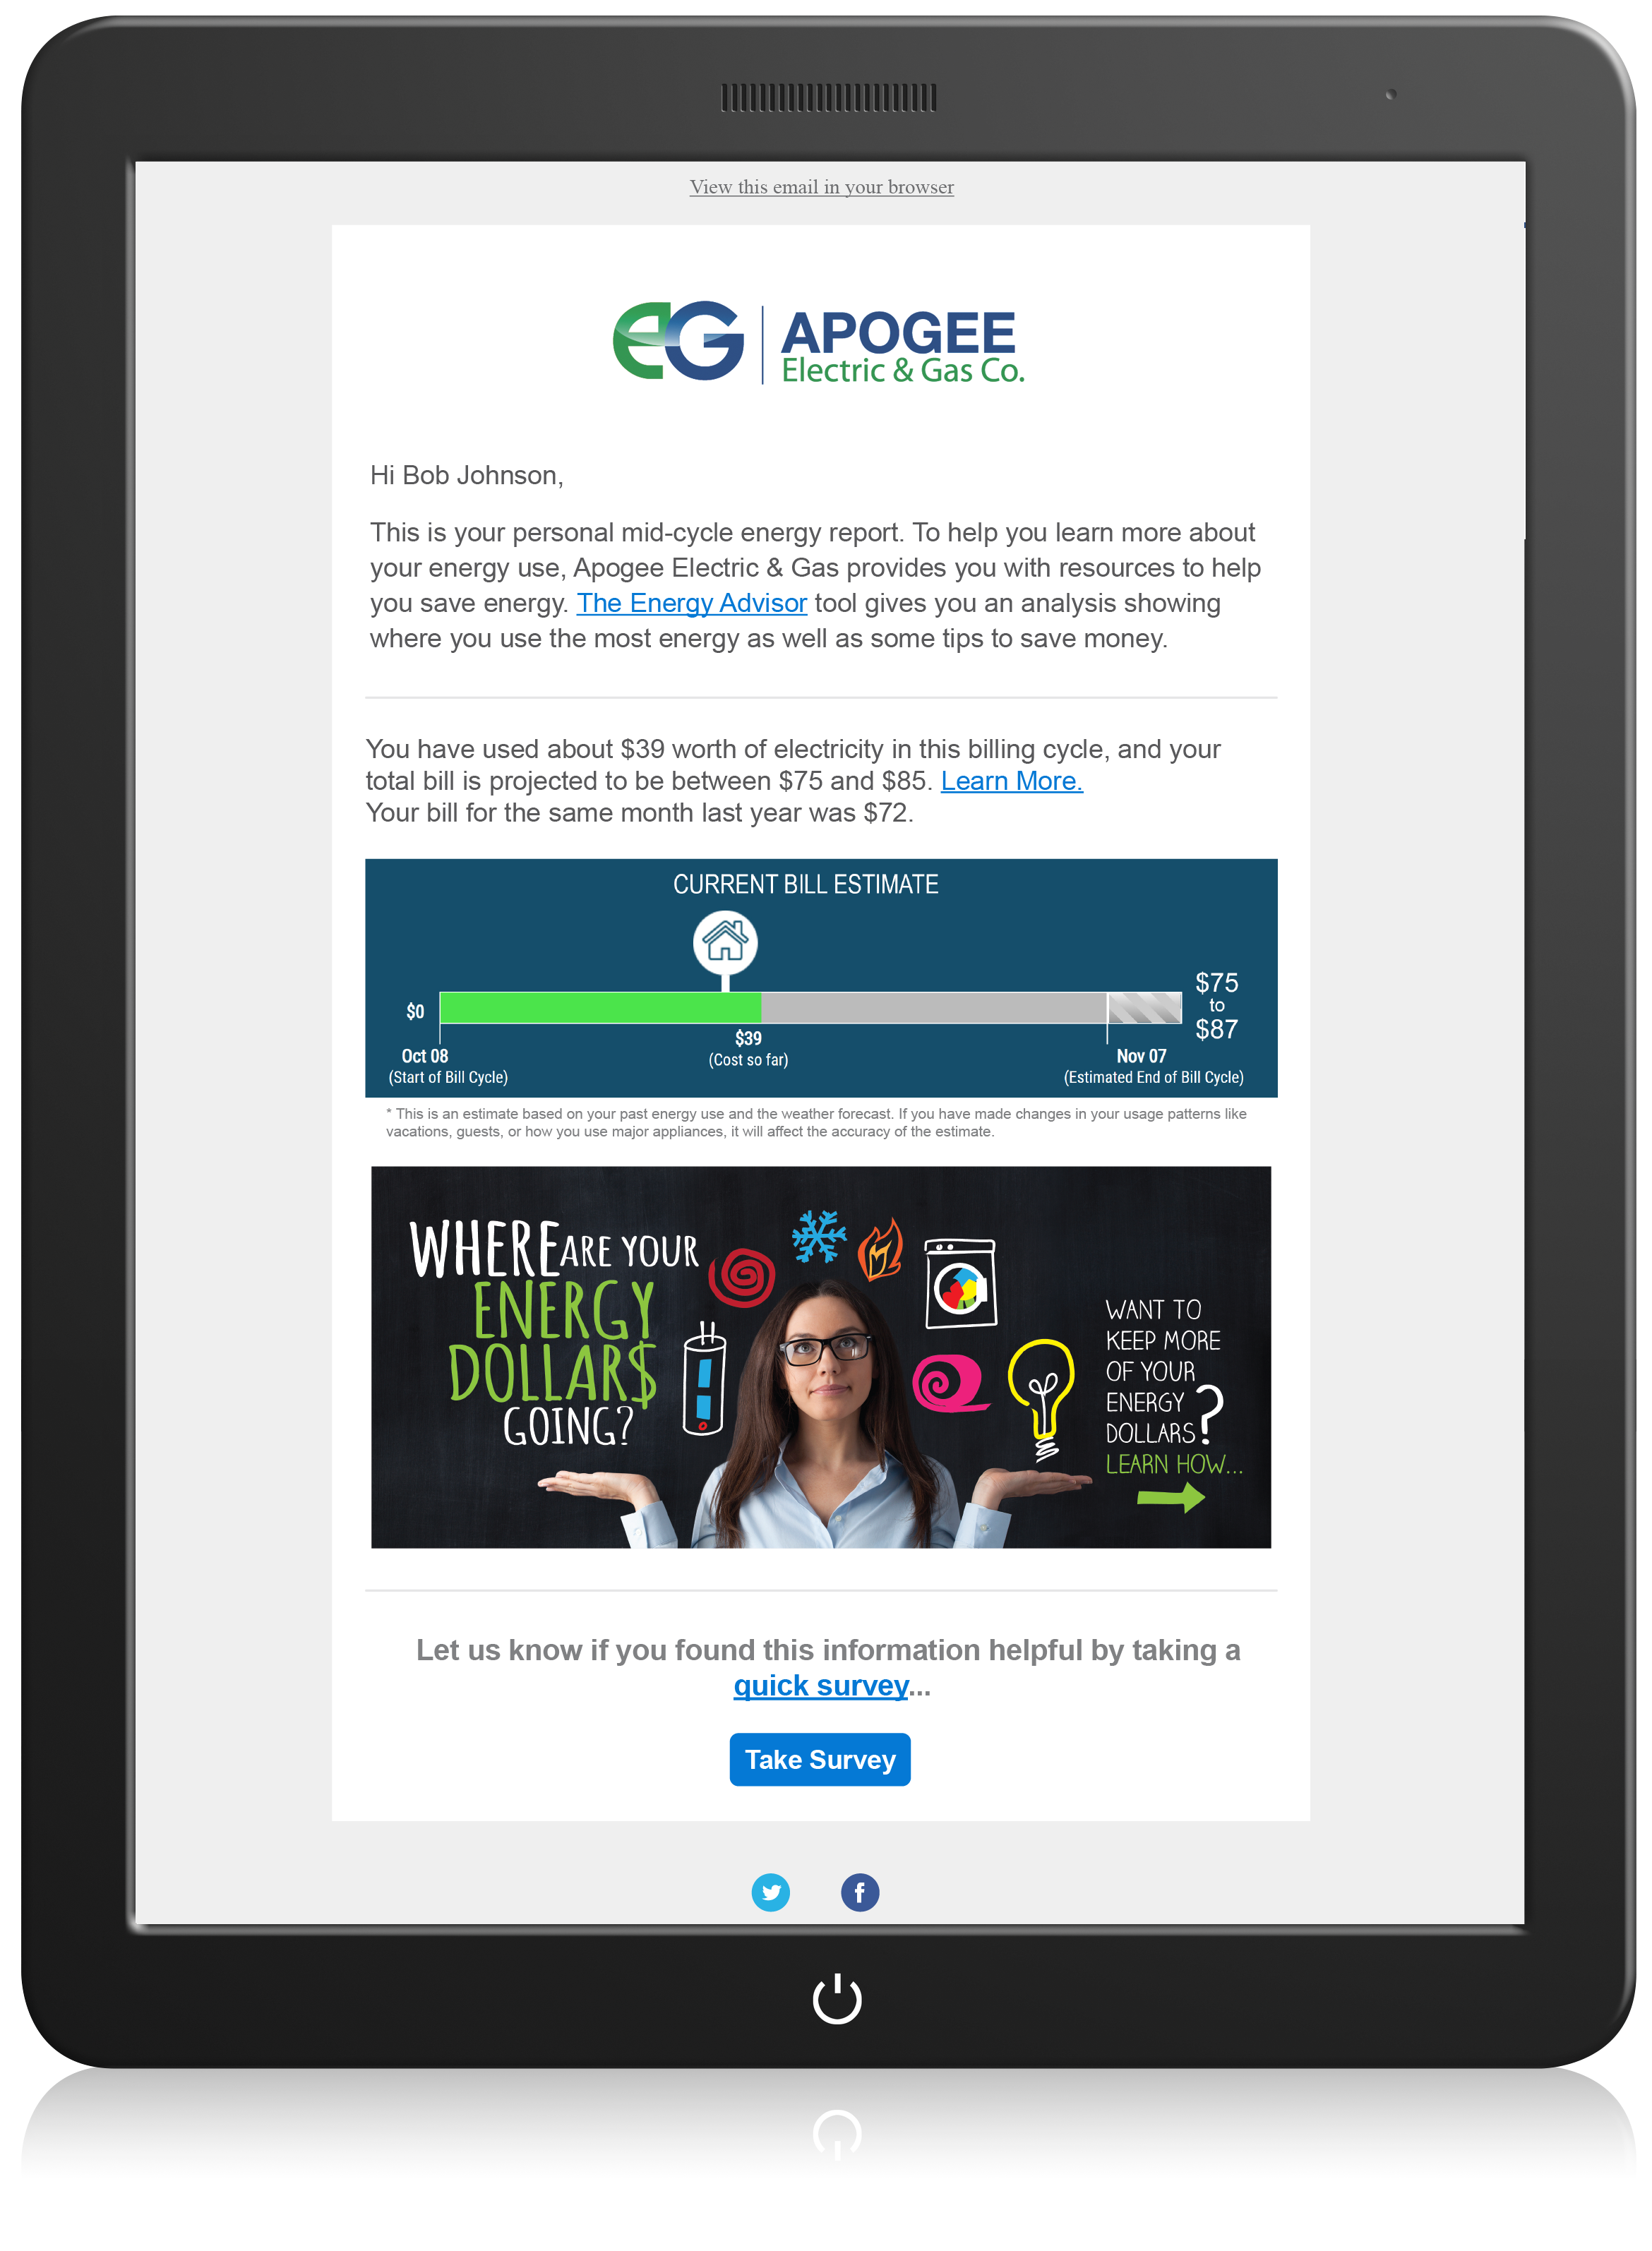
Mid-Cycle Alerts
Stellar Results
Over 154,000 Messages Sent
57% Unique Open Rate
Proactive vs. Reactive Communications
*Numbers indicate a 12-month period

Slide 11
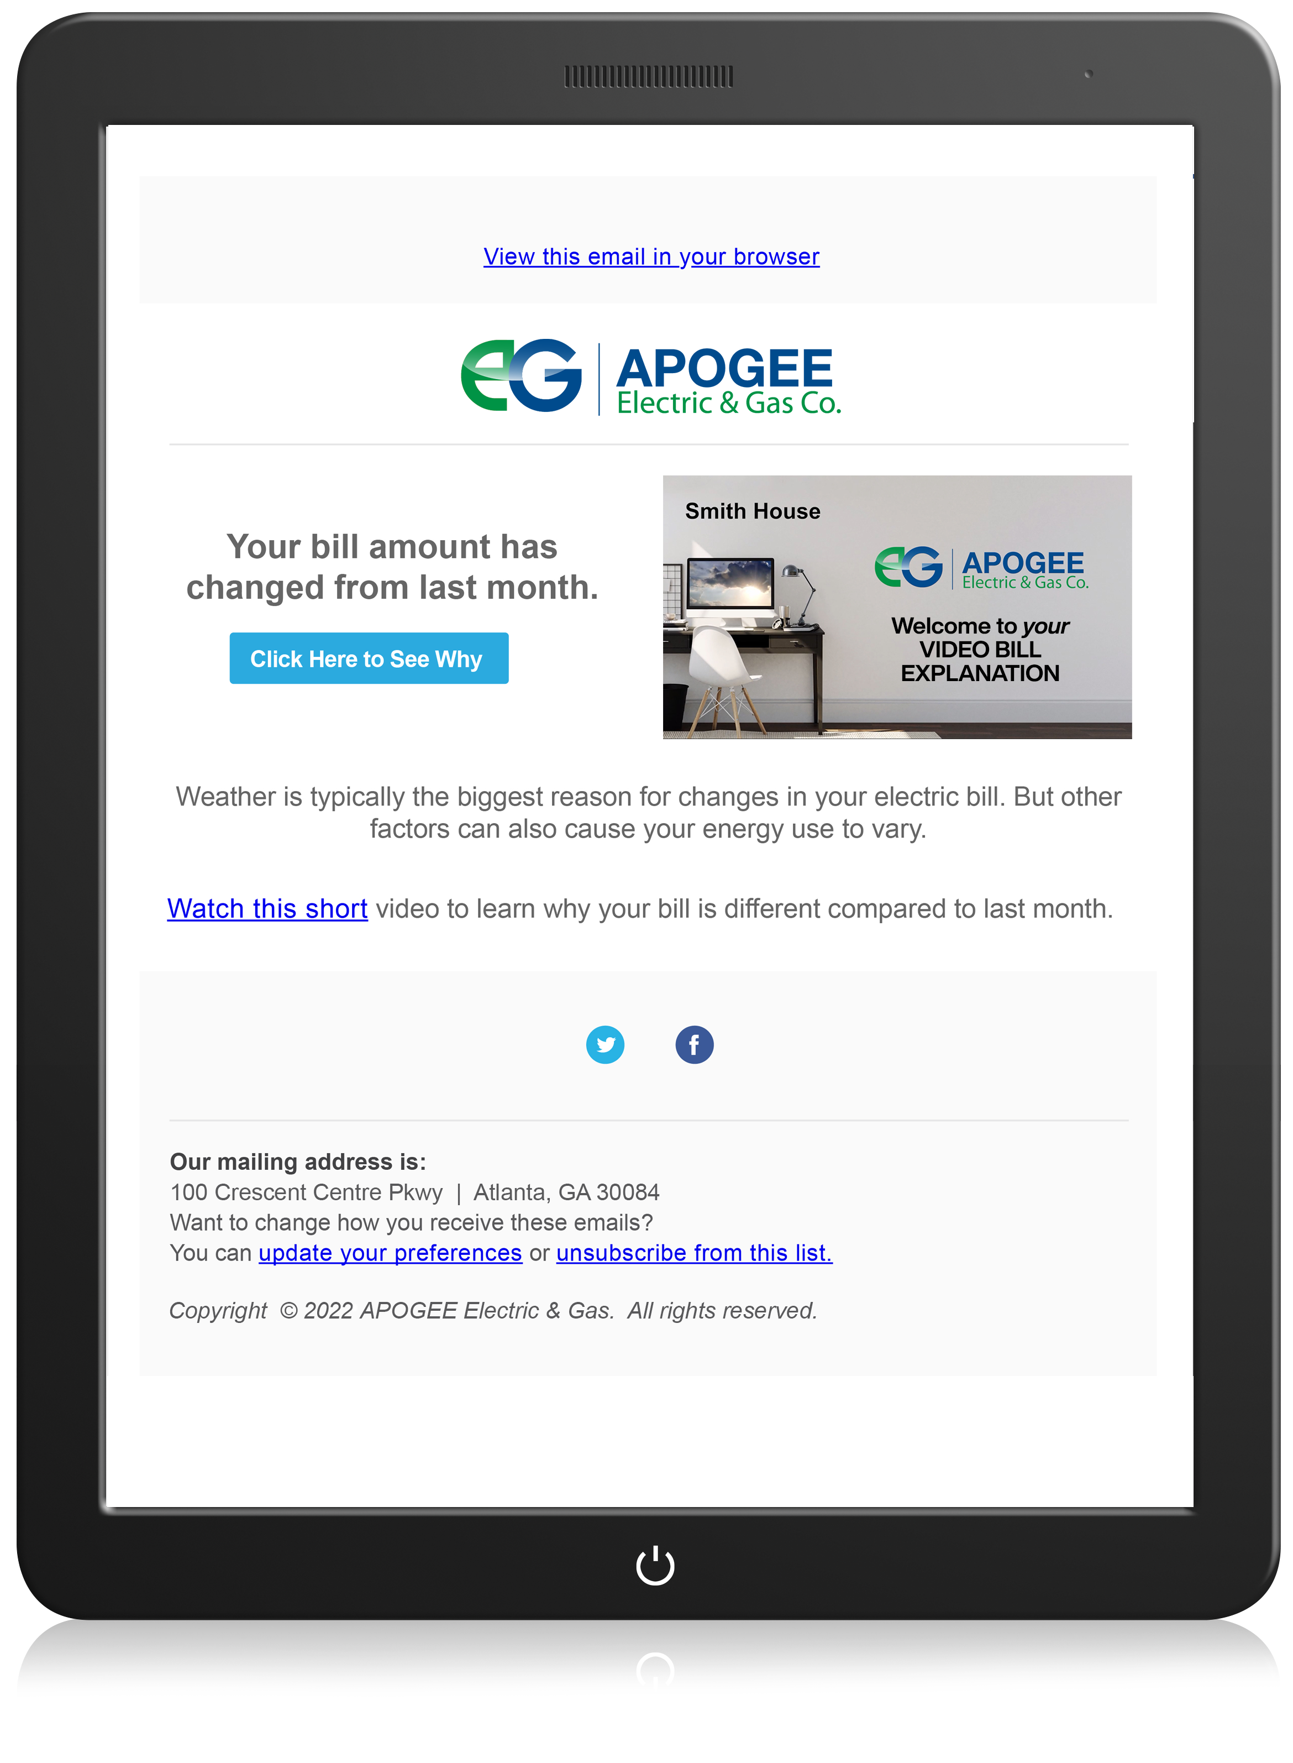
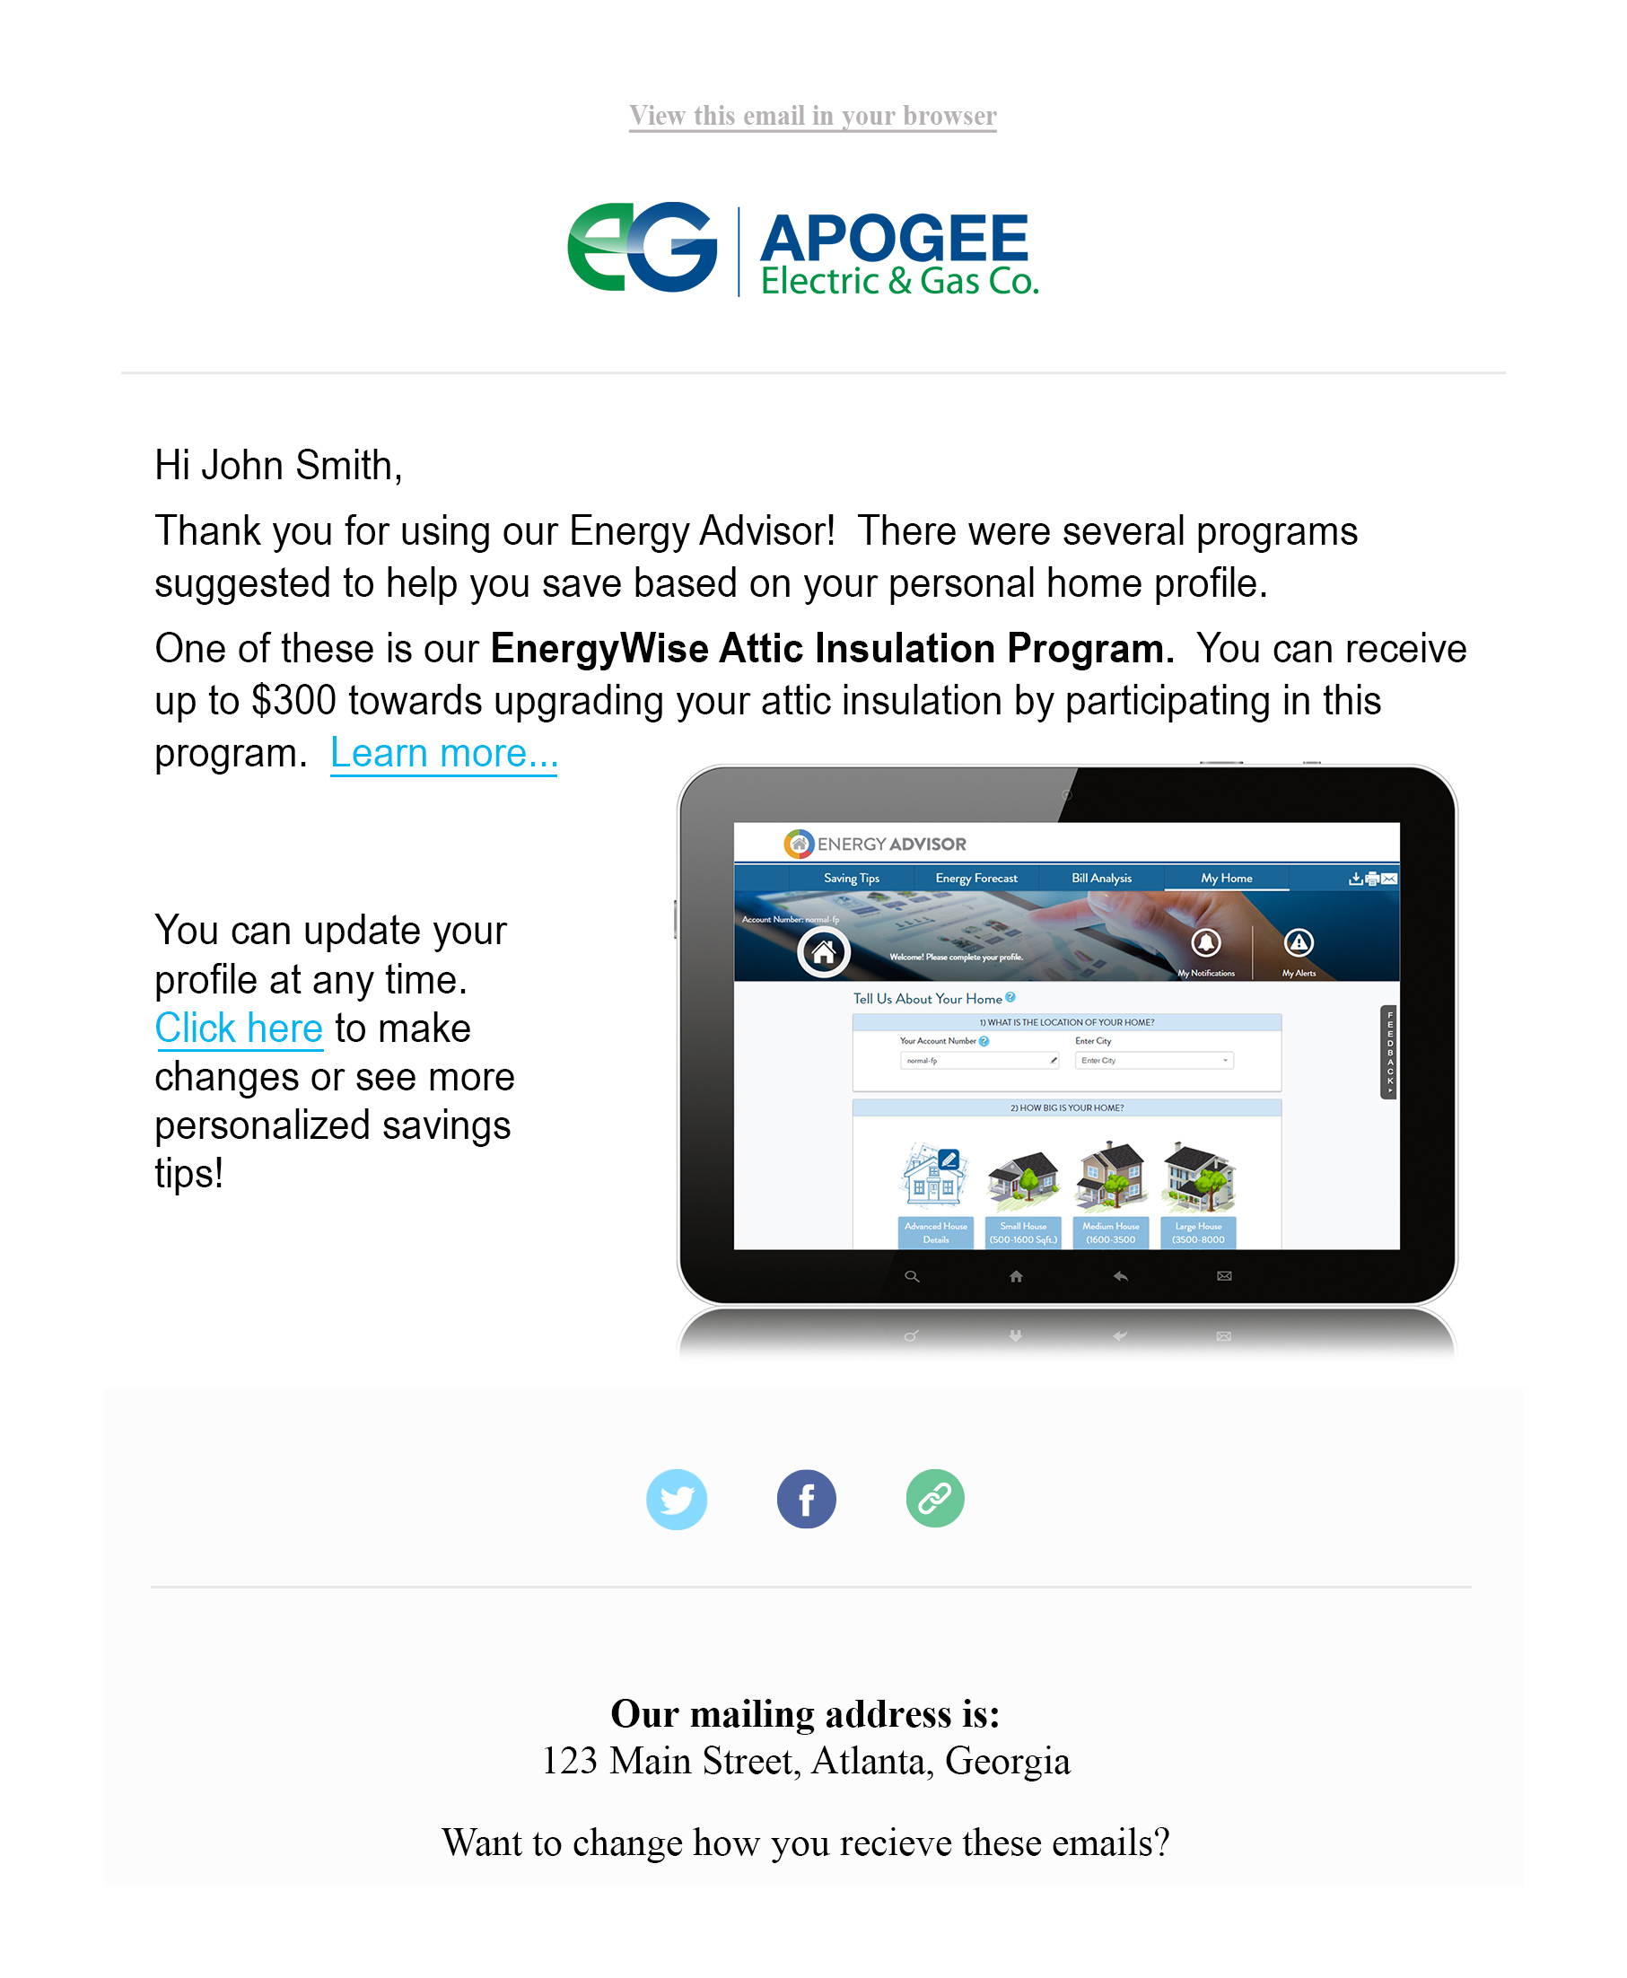
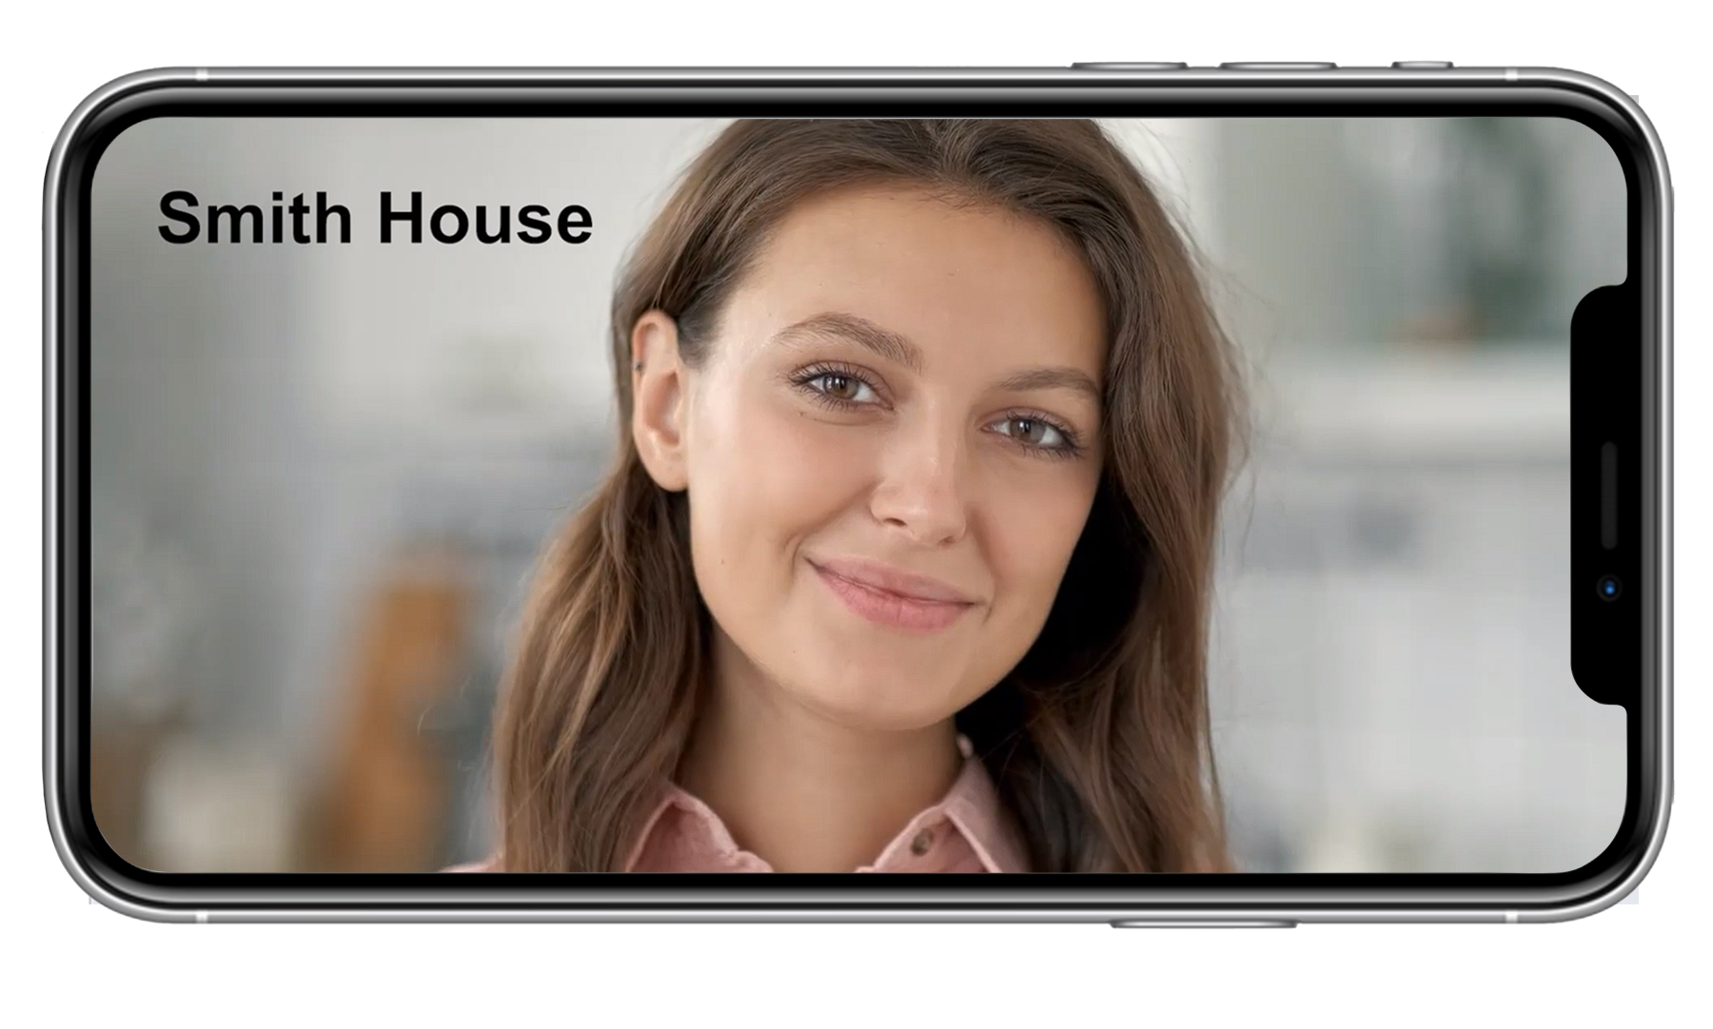
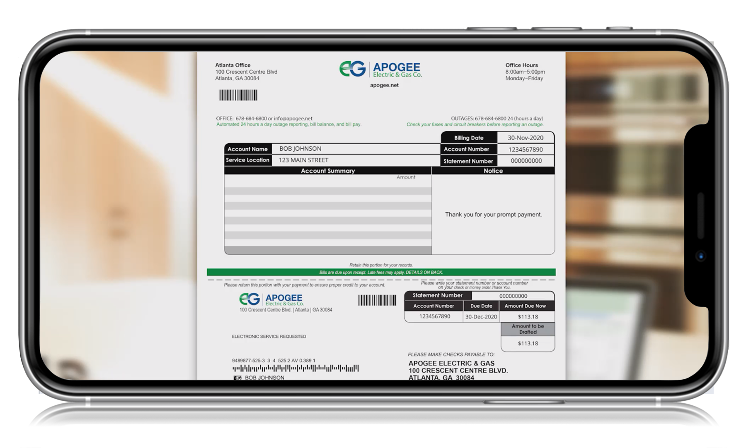
Onboarding Strategy
Welcome Series Tactics
Engage New Members From Day 1
Three step email series
Improve brand perception
Education about billing
Program awareness and Energy Efficiency
Over 6,000 Messages Sent
81% Unique Open Rate
*Began sending messages in September 2022

Slide 12
Welcome Series Campaign
7-10 Days After Service Started: “Welcome to Horry Electric” | 3-4 Days After Receiving First Bill: “Understanding Your Bill” | 3-4 Days After Receiving Second Bill: Program Promotions | 3-4 Days After Receiving Third Bill: General Video Bill Explanation

Slide 13
Lessons Learned
Horry’s membership is digitally focused
The Apogee videos and alerts are well received. Horry reaches members with relevant electronic information.
Horry has been a pioneer in digital engagement for 20 years.
In 2020, Horry dialed it up with video messaging
Members expect Digital outreach
With little effort and utility resources, ROI on digital engagement is magnificent
Horry is constantly looking out for new ways to increase member engagement. Talking with other co-ops is vital in this process.
Notes:
Ask Jennifer for examples of what not to do.

Slide 14
What To Do & Not To Do
Do not send fluffy emails
Make sure the information is relevant and concise
Communication with your team about email blasts/outreach materials
MSRs need to be aware of promotions so they can answer questions
Use multiple channels/methods for outreach (not just emails)
Social Media
Text Messages
Blog Posts

Slide 15
Q&A and Conclusions

